Slide 1
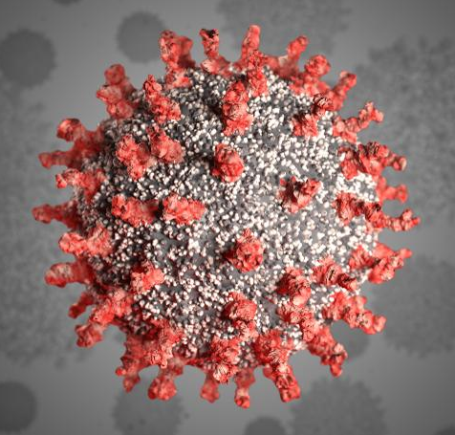
Safe to Reopen? COVID-19 Infection Modeling
Asa Kientz
Notes:
Hi, I’m Asa Kientz and I’ll be talking about modeling COVID-19 infection rates…
as well as what data exists to support decisions to reopen.

Slide 2

This is (some of) me
Mechanical Engineer (by education)
Process Engineer / Data Analyst (by career twists and turns)
(Semiconductors, Solar, Hydrogen)
Curious how systems work (by my wiring)
Curious how people behave (by my fascination)
Notes:
A little about me…
Have a background in Mechanical Engineering, but I’ve always been pulled towards the data analysis aspects of my work.
I love finding a black box and learning how I can change its inputs to create outputs.
And frankly there’s no more interesting black box to me than the human mind.

Slide 3
What’s the Plan to Reopen?
Notes:
So, what’s the plan to reopen?

Slide 4

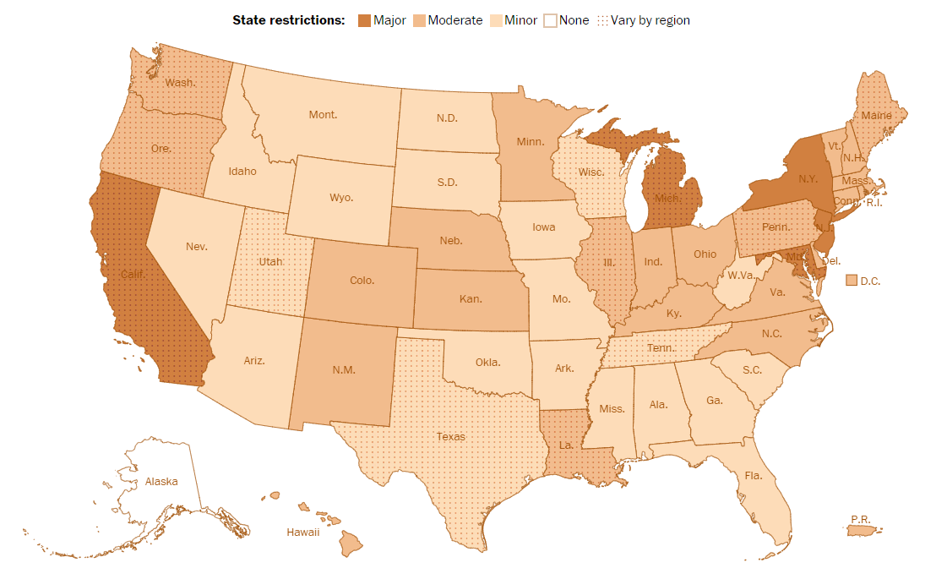
What’s the Plan to Reopen?
Source: The Washington Post, 6/4/20, Where states are reopening after America’s shutdown, https://www.washingtonpost.com/graphics/2020/national/states-reopening-coronavirus-map/
Notes:
Depends on where you live. Here, restriction levels are shaded by state.
Harder-hit areas tend to be more cautious, but there is little consistency state to state.
There are a lot of factors in play:
Many households need a paycheck
There’s shelter fatigue
There are warnings of a second peak coming
and really no unified national play book
So we get this patchwork approach.
But, what might a purely data-driven decision look like?

Slide 5
CDC Metrics to Assess Relaxing Lockdown Policy
Infection Rates dropping below a per-capita threshold
Increased testing on the general population (positive test rate should be ~2%)
A contact tracing system is in place.
Notes:
The CDC has created ONE proposal for this, with 3 metrics….

Slide 6
CDC Metrics to Assess Relaxing Lockdown Policy
Infection Rates dropping below a per-capita threshold*
Increased testing on the general population (positive test rate should be ~2%)
A contact tracing system is in place.
*CDC ‘Low Incidence’ threshold is ~0.71 new cases / 100,000 people / day.
Notes:
The infection rate threshold can help predict a reopen date.
It’s population based, and for the US, this threshold is ~2300 new cases per day. Right now, we’re still about 10x that.

Slide 7
Goals
Fit a model to the Daily Infection data for a region.
For a region, predict when infection rates will drop below the CDC threshold.
Notes:
So, my intention was to fit a model to the actual infection data, then project out when it would drop below the CDC threshold.

Slide 8
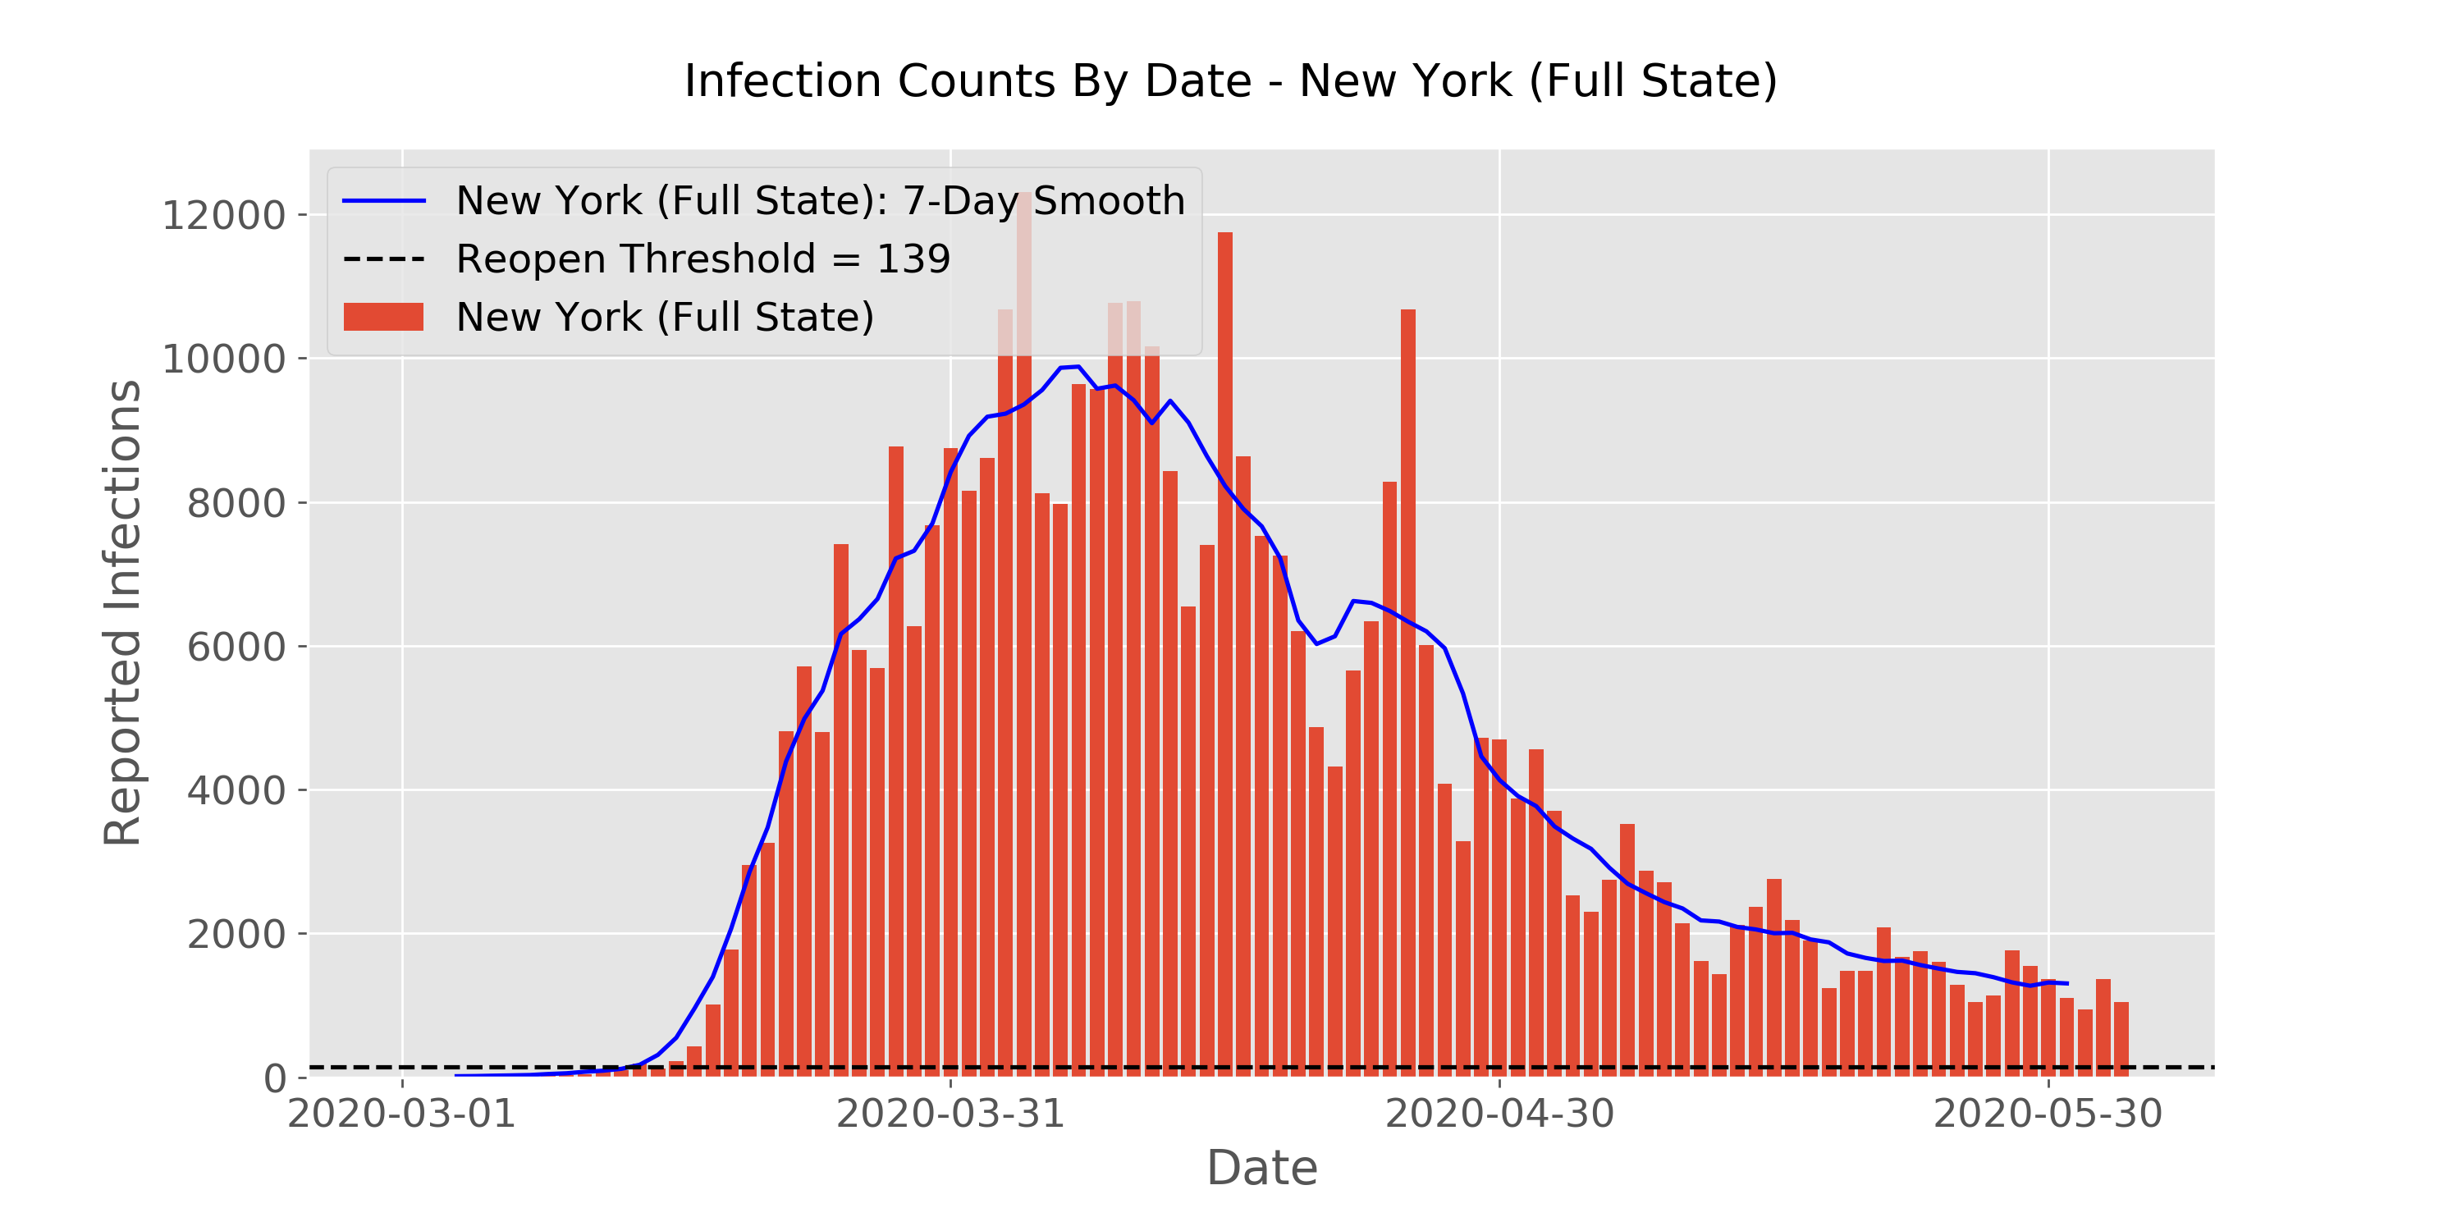
Daily New Infection Counts – New York
Notes:
Here’s an example of daily infection data – this is for New York State.
Red bars are counts of new reported infections each day.
You can see the weekly cycle of peaks and valleys (which is due to lag in reporting on the weekends), so the blue 7-day smoothed line was applied.
Given New York’s population, the reopen threshold works out to be ~140 new cases per day. That’s the horizontal black line seen near the bottom.
So…dropping but not there yet.

Slide 9
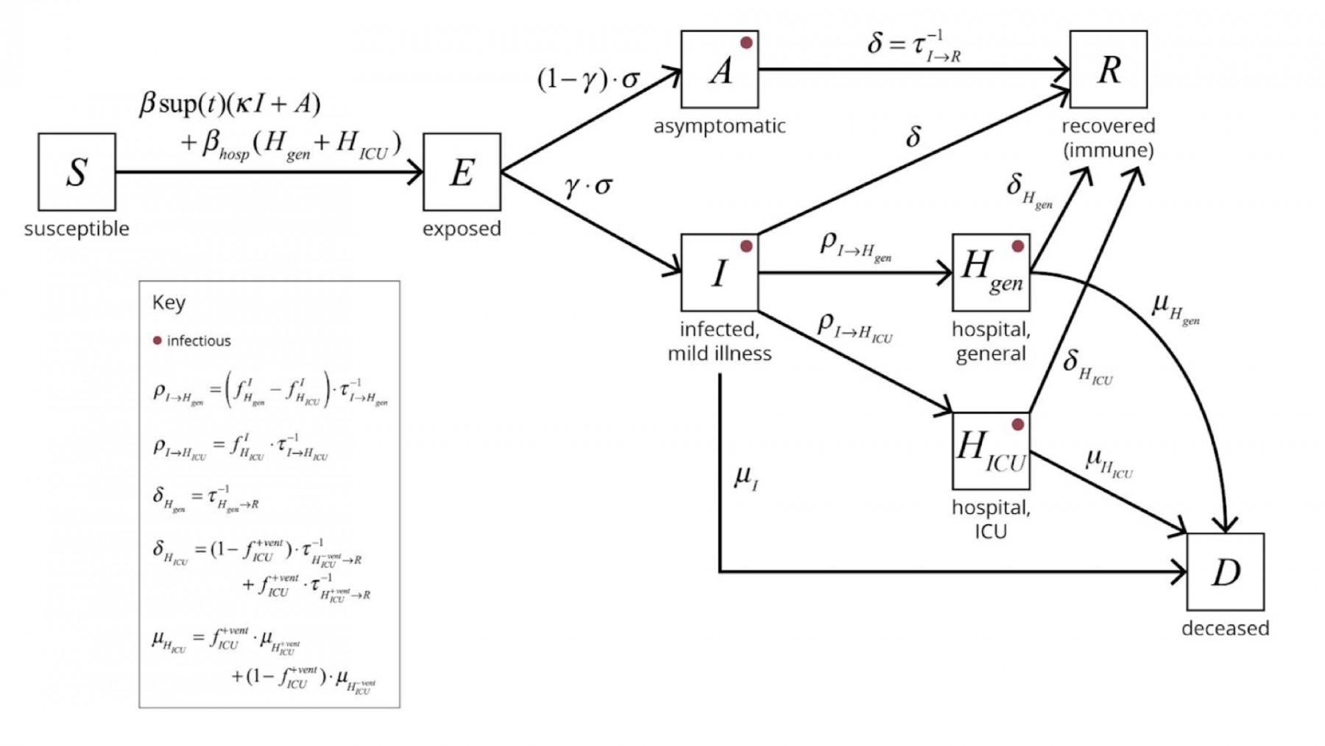
Compartmental Modeling
Notes:
OK, so that’s the metric - let’s talk about the model.
This is a Compartmental model; the typical model epidemiologists use. However this version is very complex…

Slide 10
Compartmental Modeling – Subset Selected
Notes:
Instead, I used a common subset of this model with just 4 compartments, called an SEIR model.
The 4 states represent people who are:
Susceptible to becoming ill
Exposed (Infected but not yet able to infect others)
Infected (and infectious)
Recovered
Immunity is assumed – those recovered don’t recycle back to the susceptible pool.

Slide 11
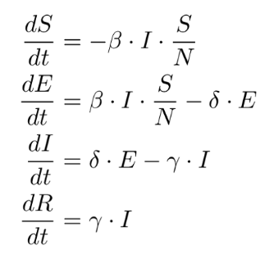
SEIR, under the hood
Notes:
So, the model really is just a set of differential equations.
By integrating these over time, the time series of each state can be obtained…
…and specifically the “Infected” time series can be used to fit to empirical data.

Slide 12
Model Assumptions
Infection data is accurate - Testing is widespread enough to catch nearly all the infections in the population.
All infections are symptomatic.
A given population is treated as homogenous (i.e., within a region/state, there are no population density or age impacts).
A single initial infection point exists per geographic area; not multiple clusters.
Each geographic unit is a self-contained region (i.e., infections only come from existing sources within and not from travel, immigration, etc.)
Immunity is assumed upon recovery – unknown still!
Notes:
There’s a whole slew of model assumptions inherent involved.
Many are due to model simplicity but also due to what we don’t know yet about COVID.
The biggest assumption is really that the infected data reported is accurate.
This is likely not so – the rate of testing being done is just too low for accurate data.

Slide 13
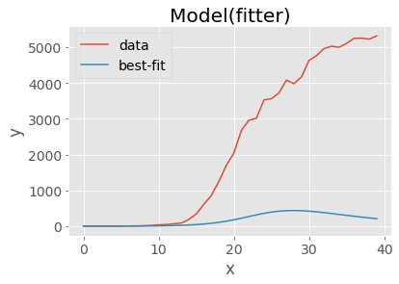
LMFIT results (SEIR model, NYC)
Infections
Days
Notes:
I tried 3 different ways of fitting a model - None of them worked well
The first one shown here is a non-linear least squares underpredicted infections…

Slide 14
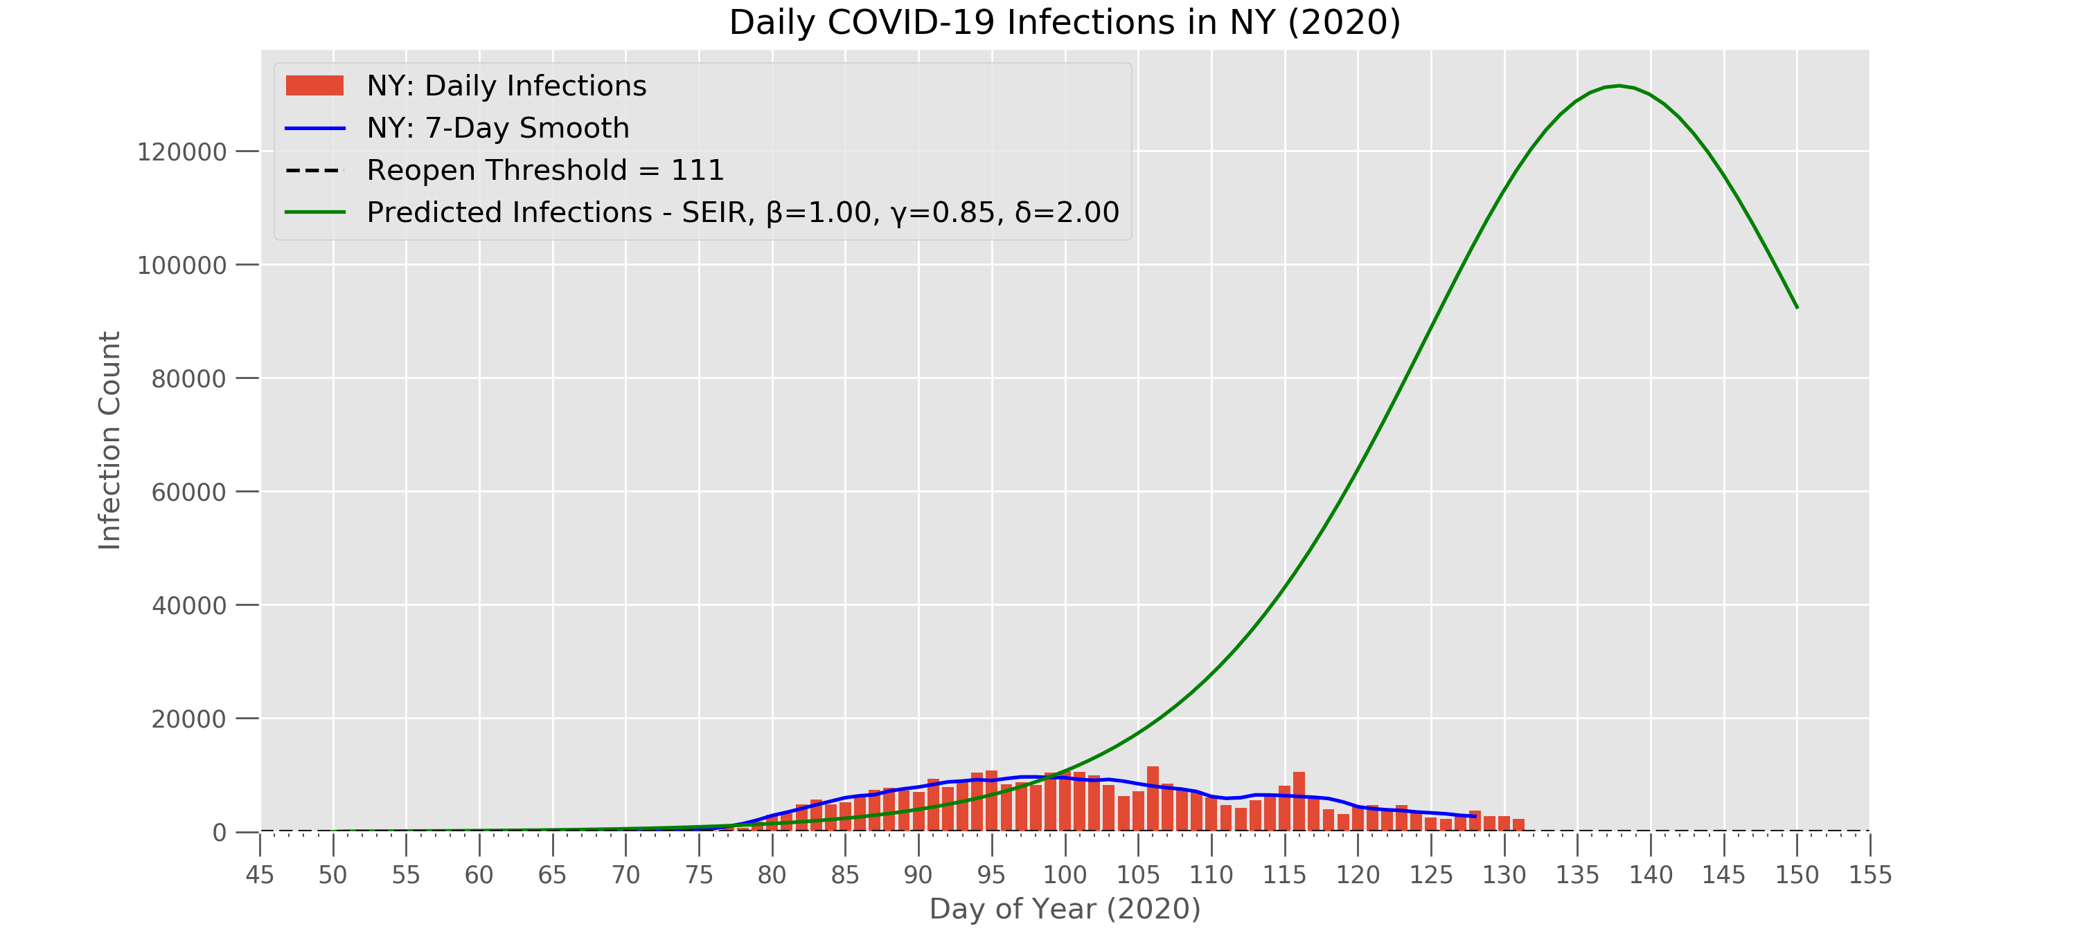
SciPy ODEINT results
Notes:
Differential equation solver overpredicted them...

Slide 15
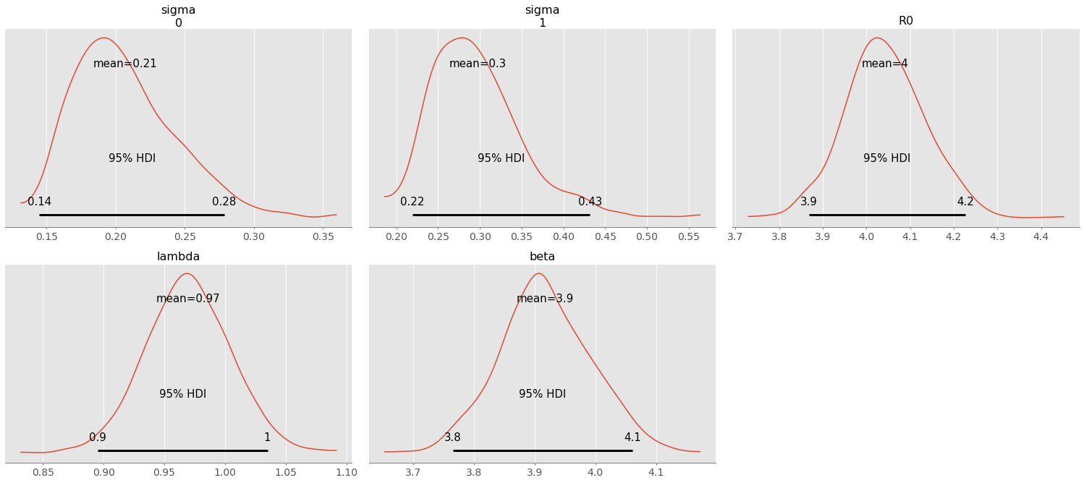
PyMC3 MCMC results – SEIR model
Notes:
The third model was MCMC - here’s the canned output. It also overpredicts infections. R0, the term for the basic reproduction number, is estimated to be around 4 at a minimum, and that would imply continued pandemic.

Slide 16
Takeaways
Too many assumptions were likely made in order to gain model simplicity.
Striking the balance between an accurate vs. usable model for a complex system can be hard.
Notes:
In setting up a model I might actually be able to run, I likely designed something that no longer represented the complexity of underlying system.
Modeling complex systems can be tricky, but I really enjoyed being challenged on this project.

Slide 17





Asa Kientz
asa.kientz@gmail.com
https://www.linkedin.com/in/asa-kientz/
https://github.com/AsaKientz

Slide 18
References
New York Times COVID-19 GitHub Repo
CDC COVID-19 Forecasts
Columbia University Epidemiology Models
Towards DataScience - Infectious disease modelling beyond the basic SIR model
Center for American Progress - Thresholds States Must Meet To Control Coronavirus Spread and Safely Reopen
Wikipedia - Compartmental models in epidemiology

Slide 19
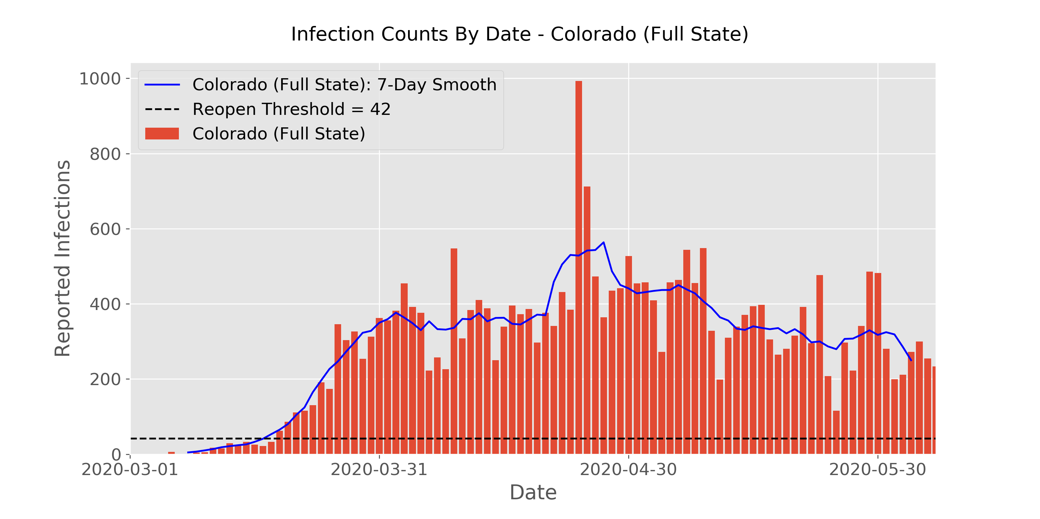
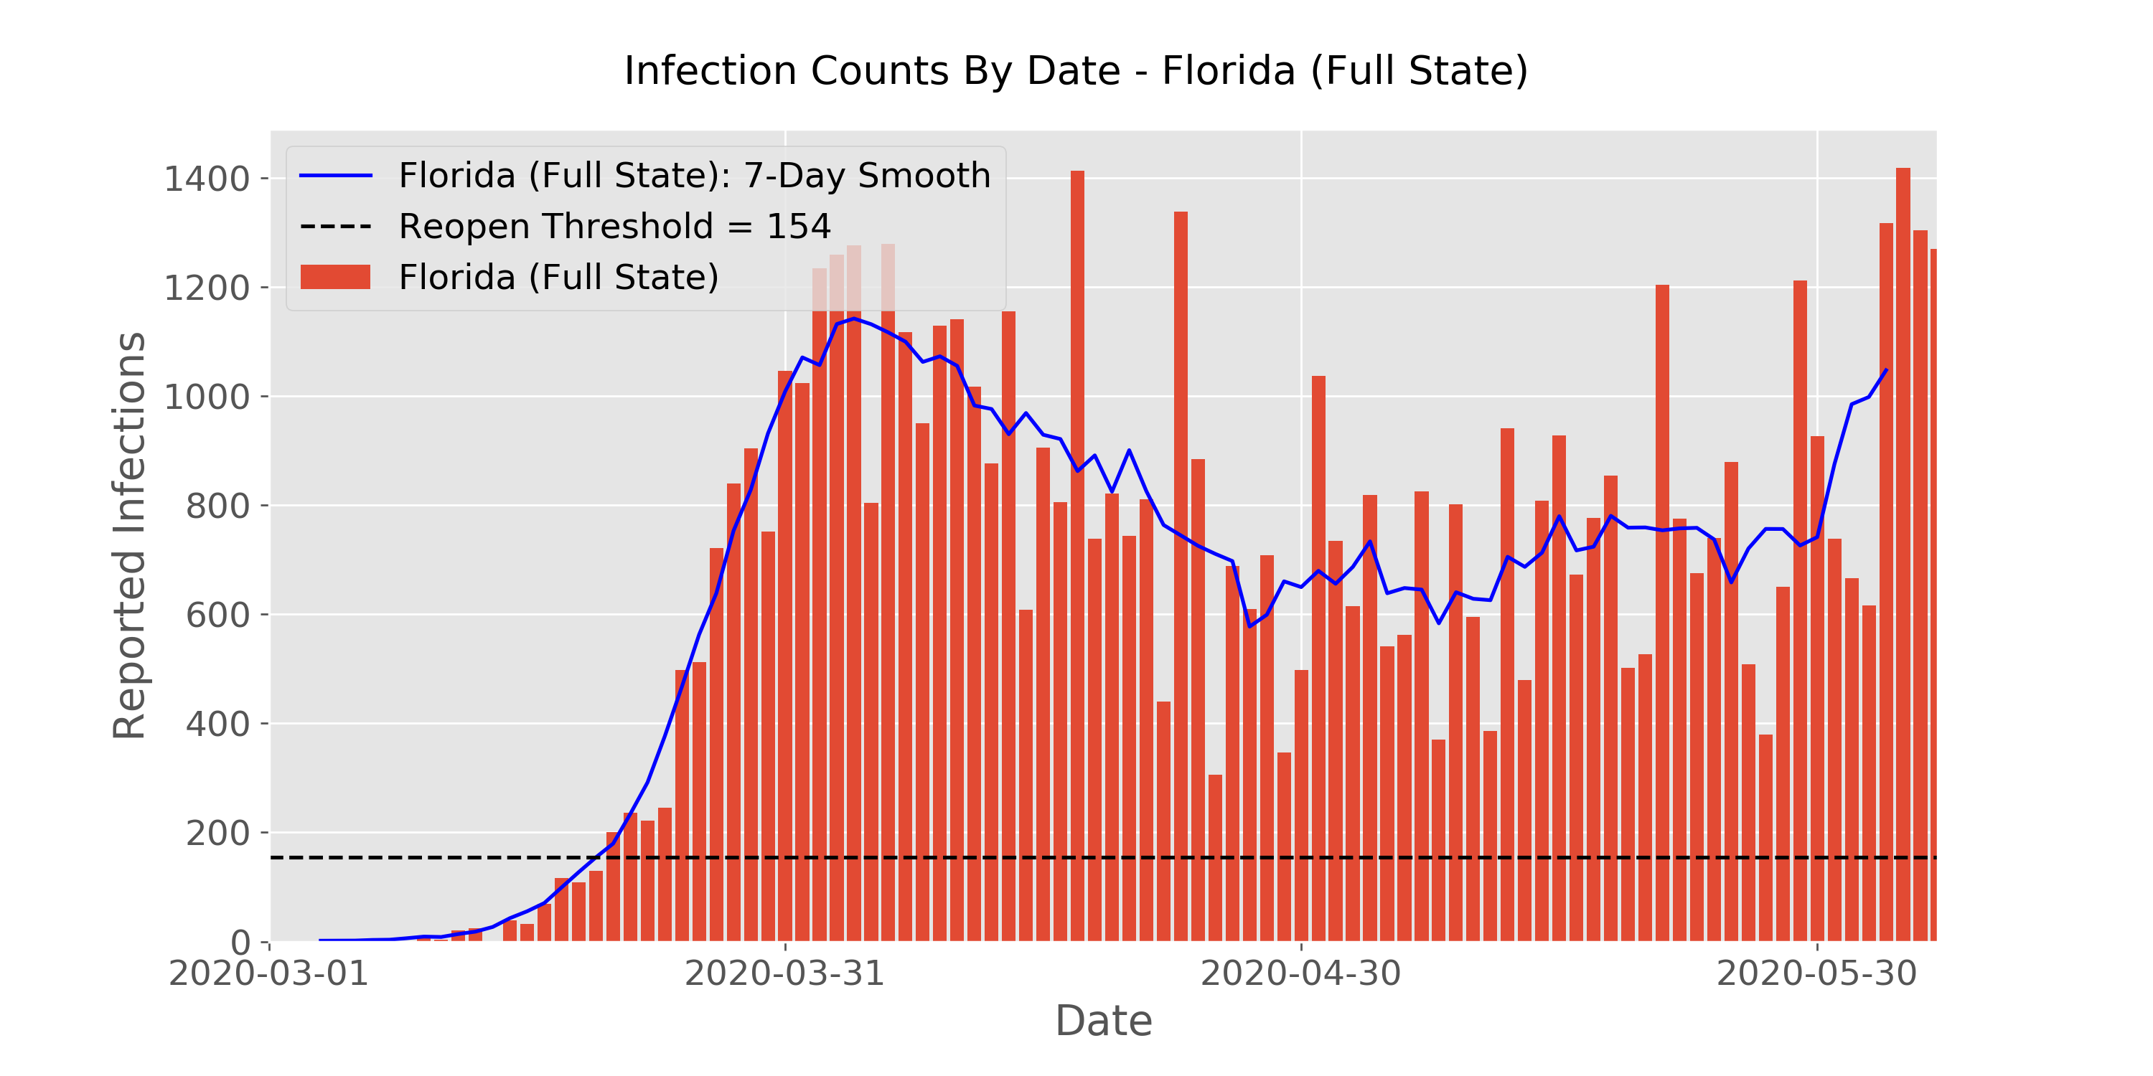
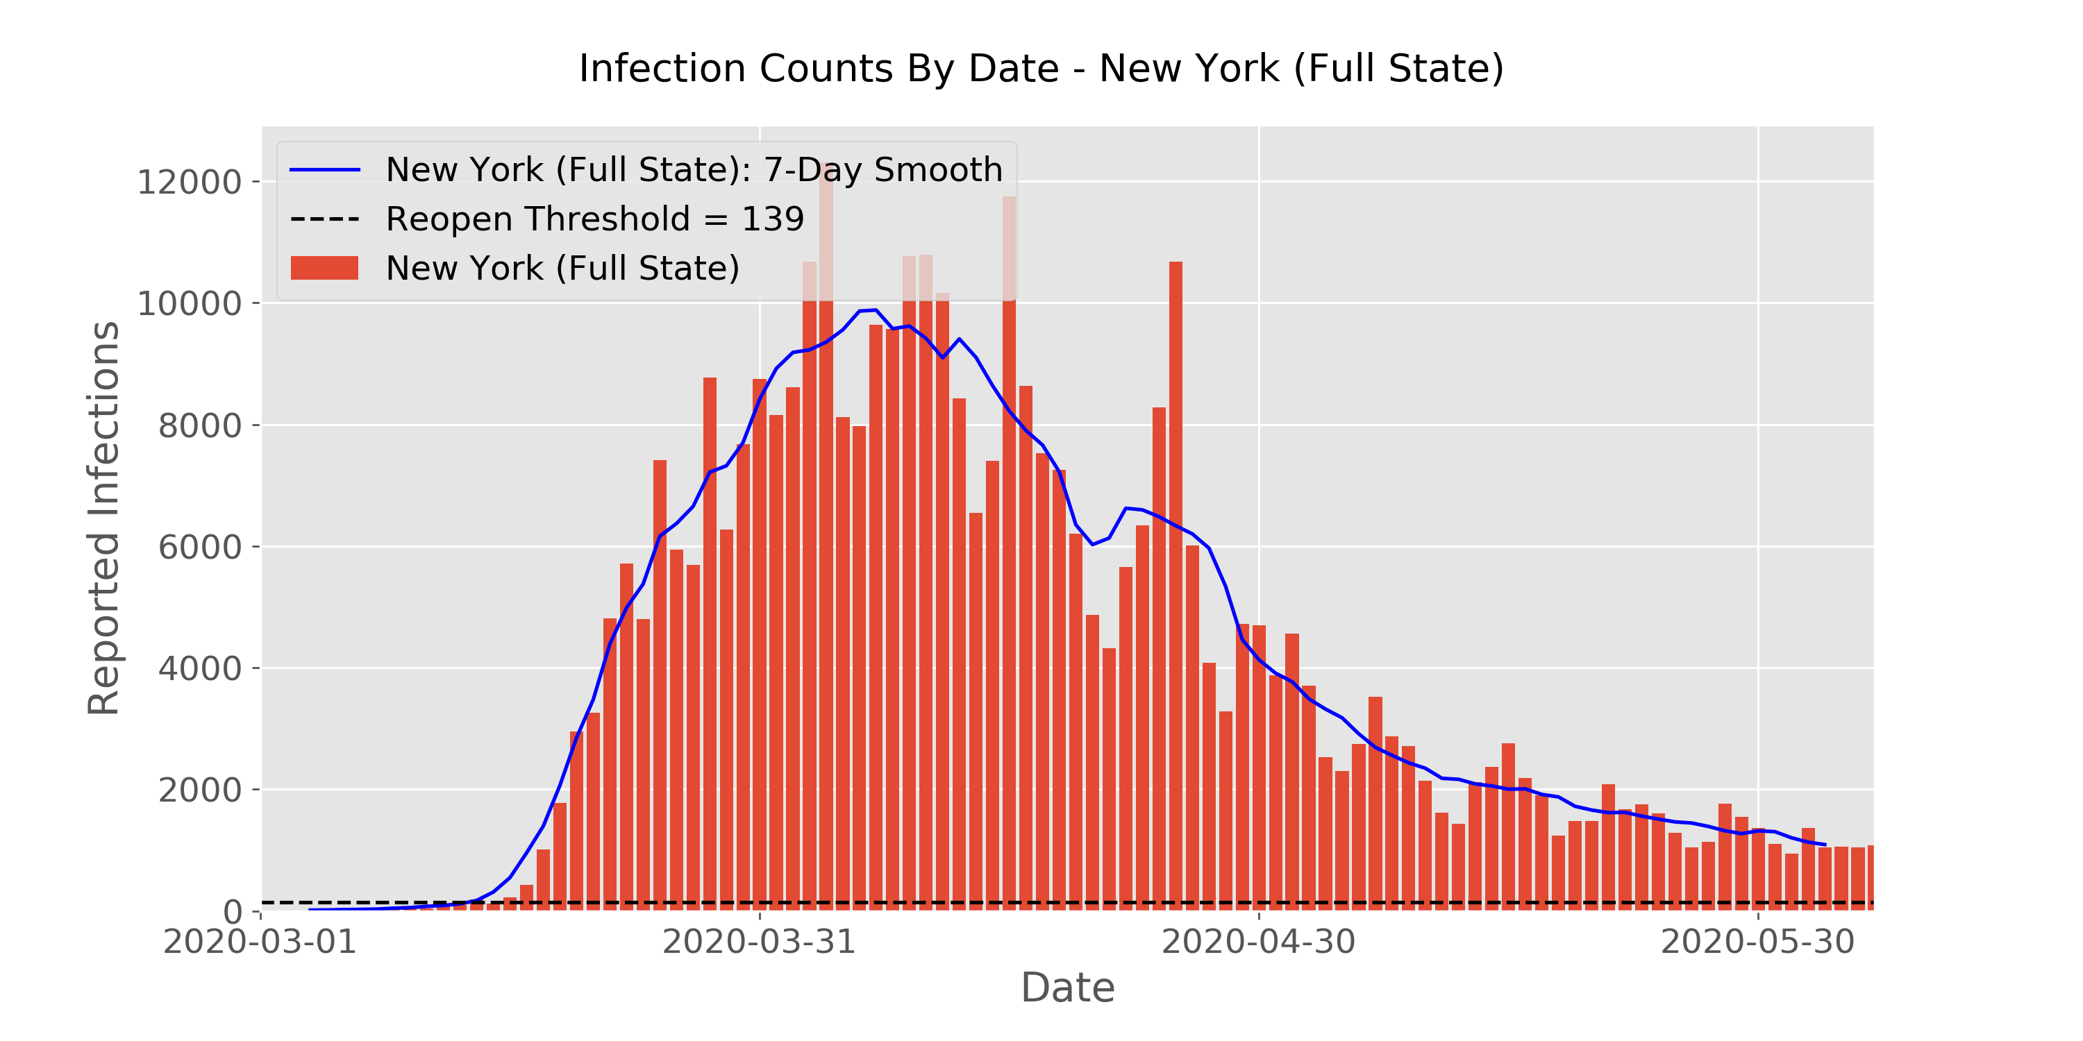
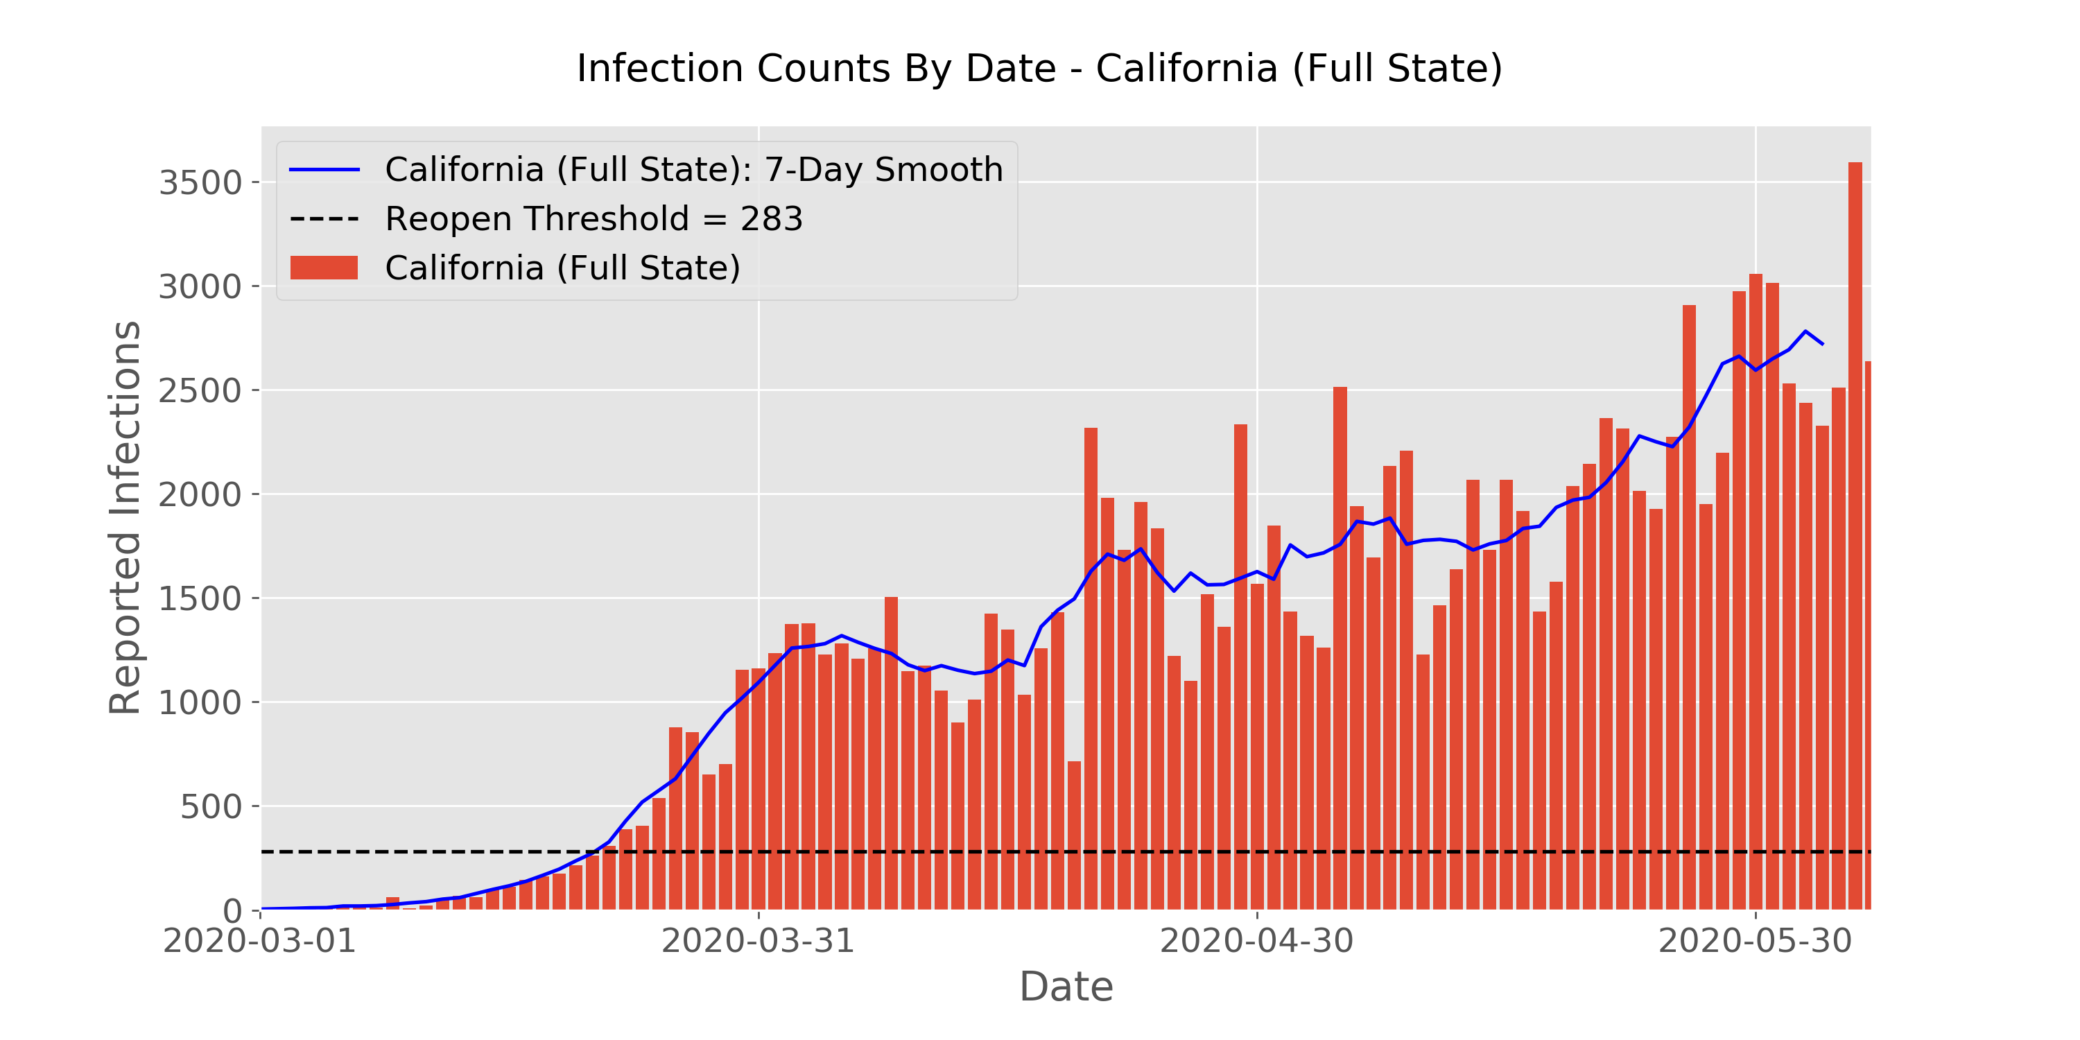
Daily Infection Trends (Select Regions)
CO
FL
NY
CA
Notes:
Here’s a series of small multiples – 4 states.
The numbers are less important than the shape and trends of the data. NY is steadily dropping, CA is the opposite, looks like the beaches in FL opened up, Colorado is slowly trending down.

Slide 20
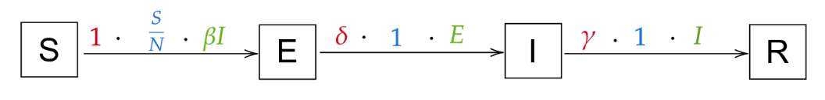
Compartmental Modeling – SEIR Model
Susceptible
Exposed
(Not infectious)
Infected
Recovered
Notes:
Here’s the view of just those compartments…in order to fit, we need to estimate some of these rate parameters

Slide 21
PyMC3 results – SEIR model
Notes:
Here’s the canned output of the MCMC model. It also overpredicts infections. The term for the basic reproduction number is estimated to be around 4 at a minimum, and that would imply continued pandemic.

